Slide 1

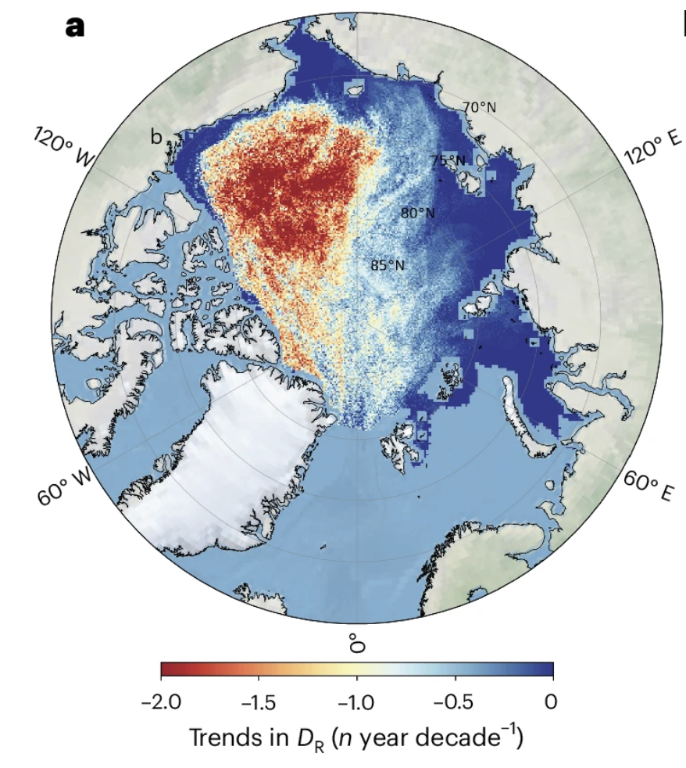
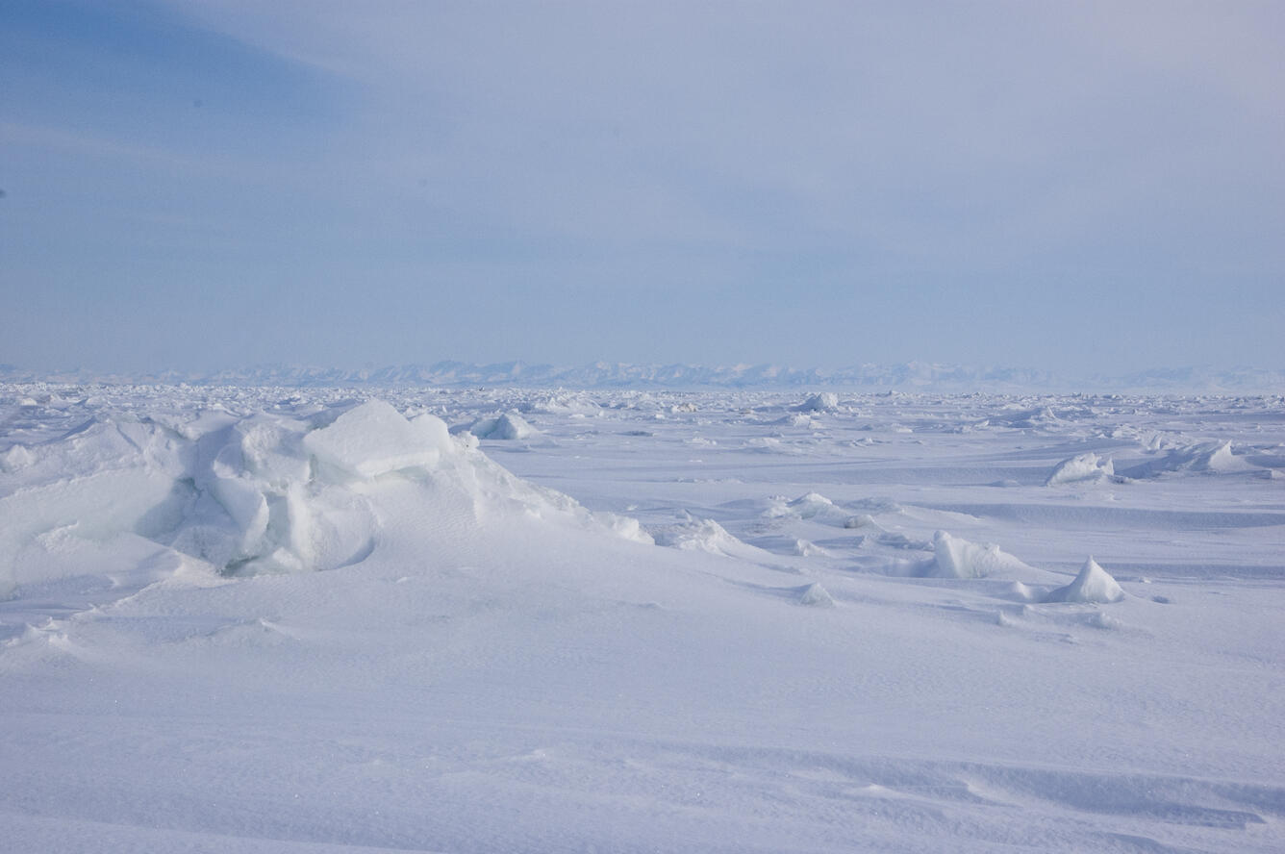
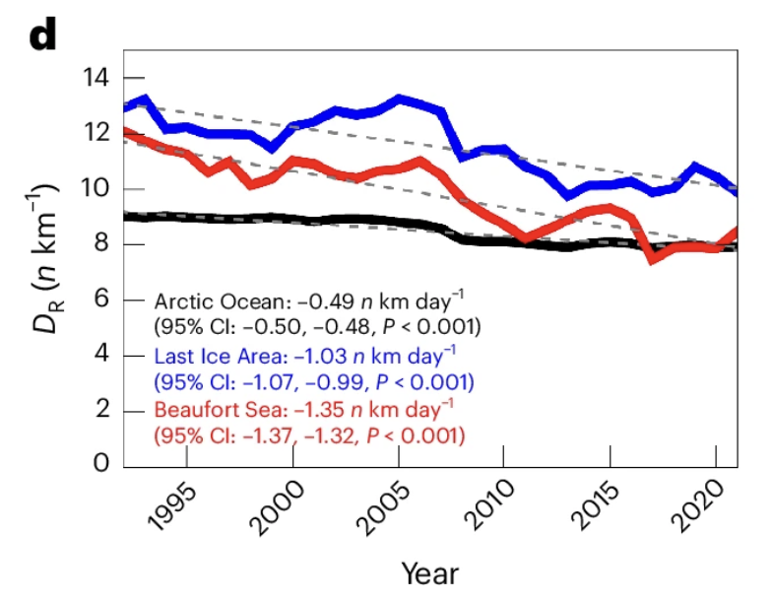

ICESat-2 and airborne data measure smoother sea ice in a more dynamic Arctic
Pressure ridges in sea ice form as ice floes push against and along each other, piling up in what can resemble a mini mountain range.
ICESat-2 and airborne observations suggest a shift towards a smoother ice surface in the Arctic, with fewer pressure ridges, due to the loss of old ice.
Thinner and fewer ridges may benefit industries such as shipping.
However, a decrease in pressure ridges impacts energy and ice mass balance, potentially influences future climate forecasts, and can negatively affect ecosystems.
Sea ice ridges
Photo Credit: Mike Lockhart, Volunteer, USGS
b
(a) Spatial trend in ridge density (D_{R}, the number of ridges per km) and (b) corresponding time series of D_{R} for the whole Arctic (black), the Beaufort Sea (red) and the Last Ice Area (blue). The approximate boundaries of the Beaufort Sea and the Last Ice Area are marked using circles in a. Trends are indicated by the dashed lines in b.
Krumpen, T., von Albedyll, L., Bünger, H.J., Castellani, G., Hartmann, J., Helm, V., Hendricks, S., Hutter, N., Landy, J.C., Lisovski, S., Lüpkes, C., Rohde, J., Suhrhoff, M., & Haas, C. (2025). Smoother Sea Ice with Fewer Pressure Ridges in a More Dynamic Arctic. Nature Climate Change, 15, 66–72. https://doi.org/10.1038/s41558-024-02199-5

