Slide 1

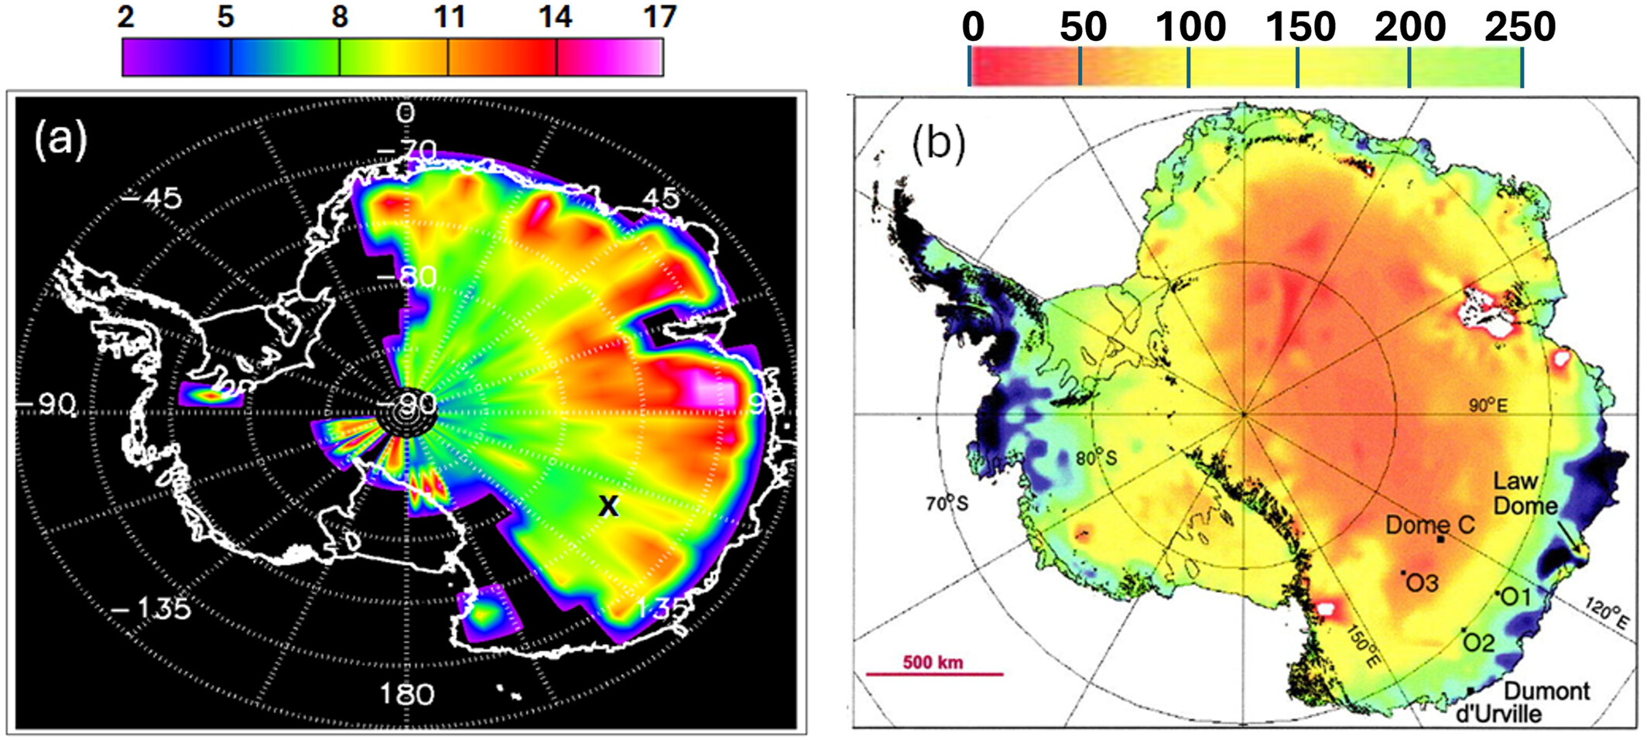
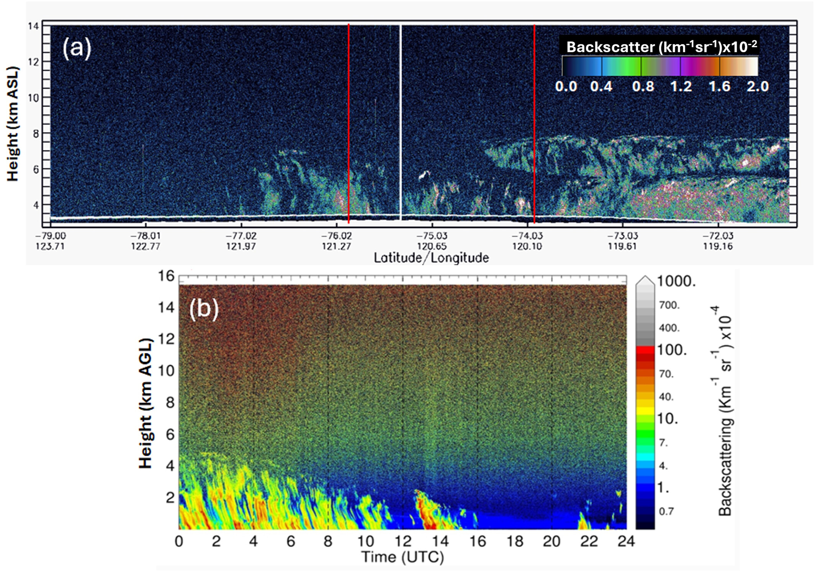

Using ICESat-2 to estimate clear sky precipitation over Antarctica
(a) Precipitation estimated from ICESat-2
(b) Precipitation minus evaporation
Precipitation over Antarctica plays a critical roles in determining the mass balance of the ice sheet but remains poorly understood.
Clear sky precipitation, ice crystals that form in extremely cold, saturated air, represents a significant portion of annual precipitation over the East Antarctic Plateau and can only be detected by lidar
Backscatter profiles from ICESat-2 were used to estimate the frequency and amount of precipitation over the Plateau.
ICESat-2 estimated clear sky precipitation agreed well with ground measurements collected at Concordia Station, Dome C.
The findings from this study demonstrate the unique ability of ICESat-2 to detect and quantify clear sky precipitation.
(a) Attenuated backscatter from ICESat-2
(b) Ground truth backscatter from Dome C
Palm, S. P., & Yang, Y. (2025). ICESat‐2 lidar estimates of clear‐sky precipitation over the East Antarctic Plateau. Journal of Geophysical Research: Atmospheres, 130(17), e2025JD044120.
Notes:
Top: (a) Ice, Cloud and land Elevation Satellite-2 estimated clear-sky precipitation (mm snow water equivalent) over the East Antarctica plateau for the period 1 April to 31 October 2021. The location of Dome C (75.1S, 123.3E) is indicated by the black “X” drawn on the image. (b) Antarctic annual precipitation minus evaporation (mm SWE) from Massom et al. (2003).
Bottom: (a) Ice, Cloud and land Elevation Satellite-2 measured calibrated, attenuated backscatter for the pass closest to Dome C on 12 April 2021, 12:29:56–12:32:03 UTC. The vertical white line marks the closest approach (75 km) to Dome C and the vertical red lines denote the approximate region used to compute the precipitation retrieval. (b) The ceilometer backscatter measured at Dome C on 12 April 2021. Note the height axis of (a) is km above mean sea level and (b) is km above ground level.

