Slide 1

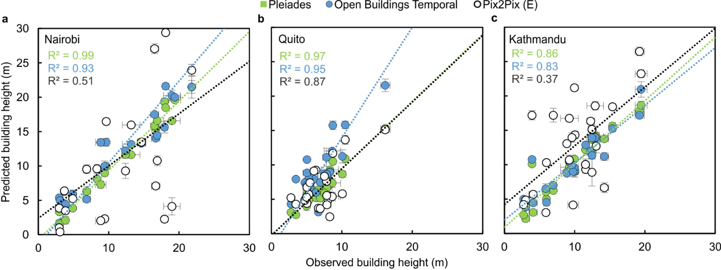
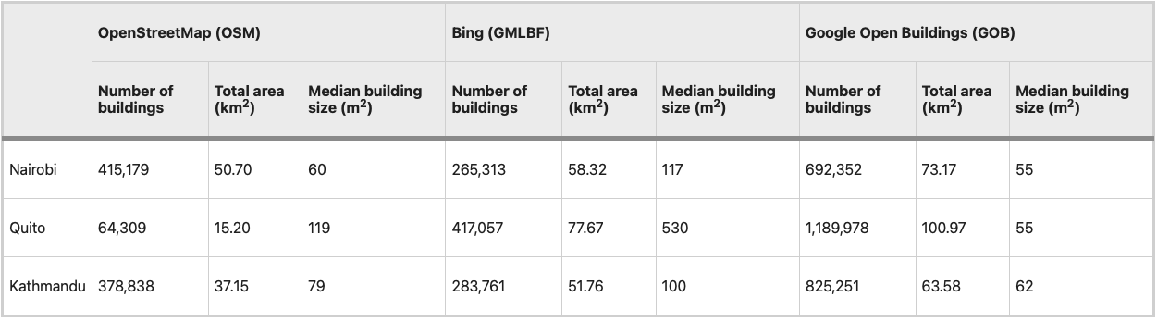

Narrowing the gap for city building height predictions
The global trend of urbanisation creates cities that are expanding horizontally and vertically, with building stocks that are redeveloping through time.
Understanding the 3D evolution of urban environments at high resolution through space and time is crucial for targeting sustainable development and enhancing resilience to hazards but usually requires expensive commercial satellite or aerial imagery.
ICESat-2 reference heights were derived for 25 buildings and used check the accuracy of the predicted building heights by Pleiadas digital elevation models (DEMs).
The Pleiades DEMs compared well with the ICESat-2 altimetry data, which were instrumental in the validation process.
Figure: ICESat-2 (observed) and predicted building heights for 3 locations
Watson, C.S., Elliott, J.R. Narrowing the gap for city building height predictions. Sci Rep15, 29913 (2025). https://doi.org/10.1038/s41598-025-15929-2
Figure: Comparison of observed (from ICESat-2) and predicted building heights

