Slide 1

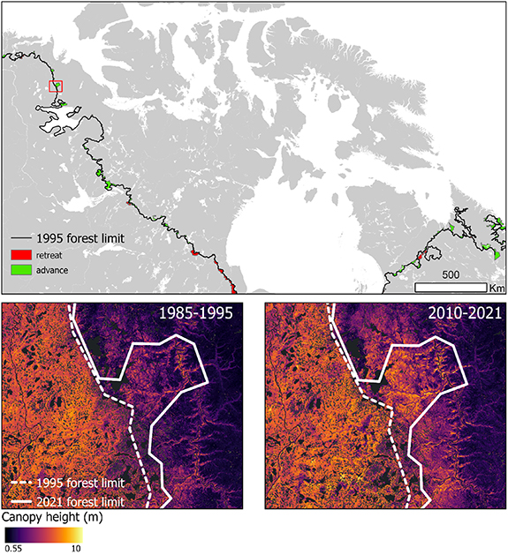

Satellite observations of forests and shrubs across Canadian Forest-tundra
Climate change at high latitudes is expected to increase the cover of woody vegetation across the forest-tundra ecotone.
Satellite remote sensing data from ICESat-2 and Landsat to model change in vegetation structure across 183 million hectares of the Canadian forest-tundra ecotone from 1985 to 2021.
Random Forests models to predict canopy presence and height across six time periods at 30 m spatial resolution.
Over the study period, the extent of forested area increased by 0.9% and the forest limit warmed by 1.08 °C, receiving 25 mm more annual precipitation, while other parts remained stable.
The findings show that increasing vegetation structure was strongly associated with fire history, highlighting the importance of disturbance-recovery dynamics in future vegetation change.
Travers-Smith, H., Coops, N. C., Mulverhill, C., Wulder, M. A., Lantz, T. C., & Ignace, D. D. (2025). Satellite observations reveal stable forest limits and shrub expansion across the Canadian forest-tundra ecotone. Environmental Research Letters, 20(10), 104006.
Mapping retreat and advance of the northern limit of continuous 3 m forest using canopy height and presence in the1985–1995 and 2010–2021 time periods. The inset map highlights a region where the forest limit has advanced northward. The canopy height data is mapped at 30 m spatial resolution.

