Slide 1

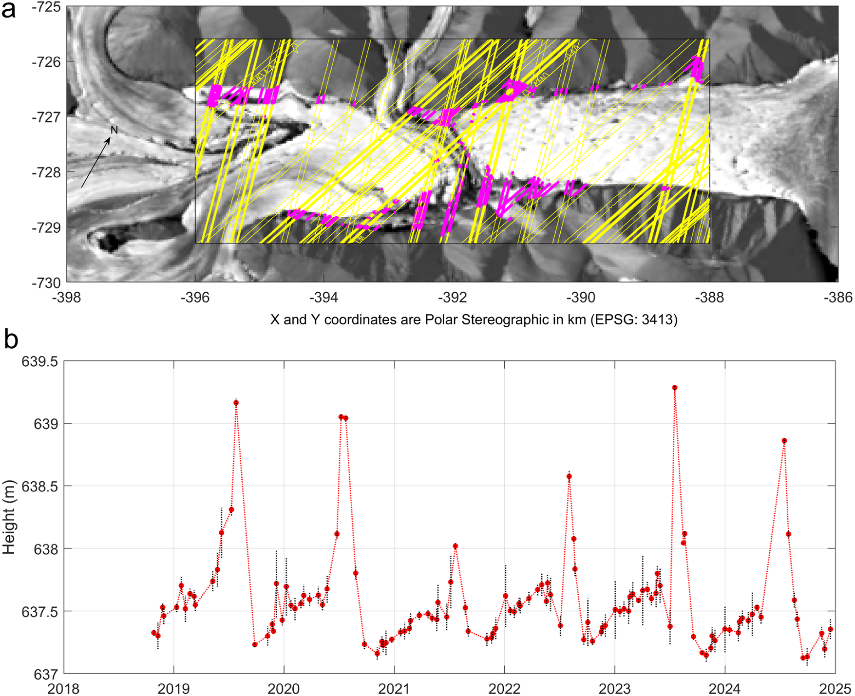

Height change of glacial ice reveals melt water movement
Models and ground measurements indicate that subglacial water can facilitate or impede ice movement depending on the circumstances.
The dearth of information related to subglacial water movement, presence and amount make future estimates of melt contributions to sea level rise is challenging.
In this study, ICESat-2 height data were coupled with ArcticDEM strips to provide new insights on the presence and movement of subglacial water.
ICESat-2 heights confirmed that each melt season (2019–2024), the height change of melt water at the basin edge matches that over ice in the basin middle.
The study showed that summer height increases occur simultaneously with an upstream drop in surface elevation, illustrating that the melt water moves both spatially and temporally.
Gray L (2025) Subtle height change reveals melt water movement around and under glacial ice, an example from northern Ellesmere Island, Canada. Journal of Glaciology 71, e107, 1–8. https://doi.org/10.1017/jog.2025.10090
(a) The yellow lines show the positions of the ICESat-2 ground tracks; magenta dots indicate the positions of ICESat-2 height estimates when there were at least 10 samples for that particular beam with heights less than 640 m. Each point in (b) represents the average of the 10 lowest height estimates from these ICESat-2; black dotted vertical line at each point represents plus and minus one standard deviation.

