Slide 1

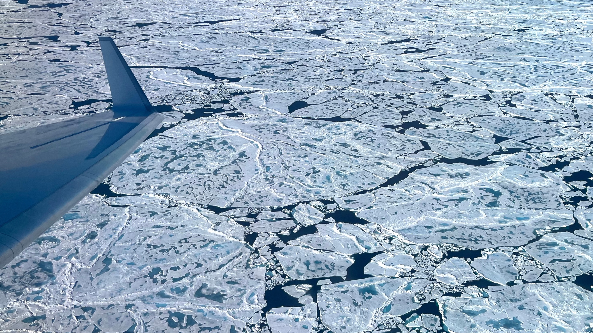
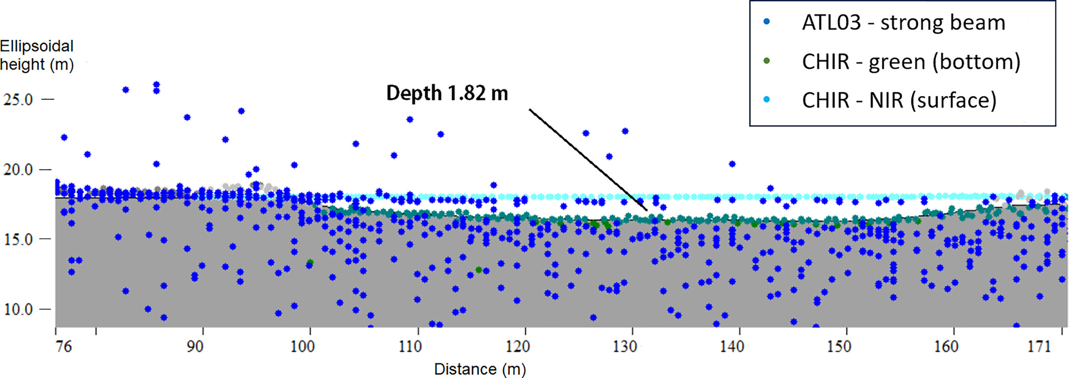

ICESat-2 Arctic Summer Sea Ice Cal/Val, Greenland 2022
A NASA-funded airborne lidar campaign was deployed north of Greenland to evaluate ICESat-2 retrievals of summer sea ice heights and melt pond characteristics.
A Leica Chiroptera-4x (CHIR; a waveform lidar) was mounted onto a Gulfstream V Aircraft alongside NASA’s Land, Vegetation, and Ice Sensor (a wide-swath imaging laser altimeter).
11,000 km² of sea ice measurements were collected, mostly coincident with ICESat-2 observations after drift correction.
When compared, the CHIR and LVIS measurements of sea ice height showed a high-level agreement and low bias. The CHIR measurements agreed well with the ICESat-2 ATL07 product heights.
CHIR data also confirmed melt pond signals are visible in ICESat-2 ATL03 photon clouds
The study showed that the sea ice community could benefit from CHIR lidar data, high-resolution imagery and the novel LidarShift algorithm for aligning lidar and ICESat-2 data
Melt ponds on Arctic summer sea ice seen from NASA’s Gulfstream V Aircraft, July 2022.
Saylam, K., Averett, A. R., Andrews, J. R., Short, S. R., Kurtz, N. T., & Tilling, R. L. (2025). Airborne lidar to verify ICESat‐2 Arctic summer sea ice heights and melt
pond depths: Calibration and validation campaign, Greenland 2022. Earth and Space Science, 12, e2024EA004100. https://doi.org/10.1029/2024EA004100
Cross‐section of the adjusted melt pond where both CHIR and ICESat‐2 registered measurements. CHIR green returns indicate the melt pond bottom, aligning closely with ATL03 photons.

