Slide 1

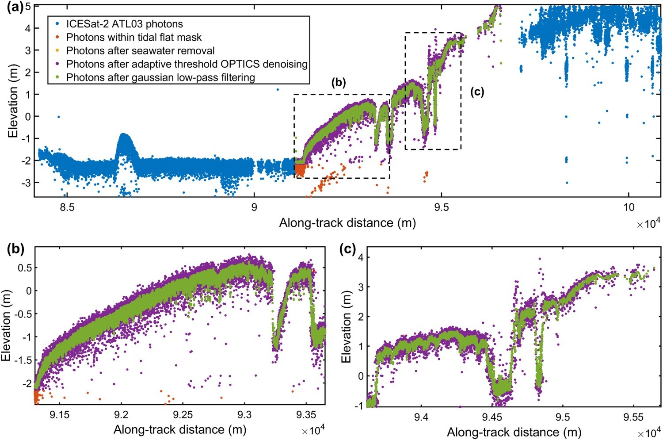

Mapping tidal flat topography using ICESat-2 and satellite imagery
Tidal flats, transition zones between the land and sea, provide valuable habitat for many species, including birds, crabs and fishes.
Both human activities and natural occurrences have resulted in widespread erosion and significant loss of the tidal flats globally.
In this study, multi-source satellite imagery along with ICESat-2 altimetry data were used to construct the tidal flat topography, including inundation frequency maps.
The study resulted in a reliable, portable and rapid method for high-frequency monitoring of tidal flat topography and to facilitate decision-making for sustainable coastal development worldwide.
(a) Detailed process of the tidal flat elevations extraction using a multi-level method based on ICESat-2 data. (b) and (c) Typical examples of final ICESat-2-derived elevation results.
Huichao Xin et al. (2025) Mapping tidal flat topography by combining ICESat-2 laser altimetry and multi-source satellite imagery, International Journal of Digital Earth, 18:2, 2554313, DOI: 10.1080/17538947.2025.2554313

